Slide 1
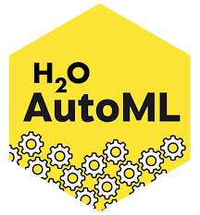
What is H2o AutoML?
H2o AutoML can be used for automating the ML workflow which includes automatic training and tuning on many models within user specified time limit.
More Data + Better Models = Better Predictions

Slide 2

Features
Open-source, in-memory prediction engine with linear scalability.
Provides a simple function that performs modelling related task automatically.
Easy to use and adopt.
Time limit.
Limit on total number of models to be trained.
Easily deployable models to production as pure Java code.
Seamlessly works on Hadoop, Spark, AWS, your laptop, etc.
Can be saved in mojo, pojo or pickle format.

Slide 3
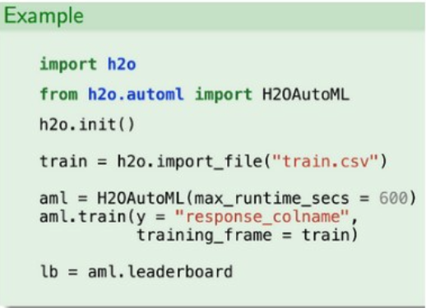
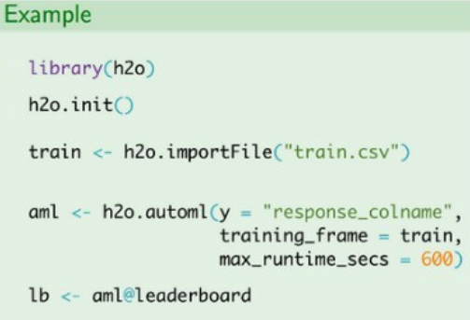
AutoML Interface
H2O AutoML has an R and Python interface along with a web GUI called Flow. The H2O AutoML interface is designed to have as few parameters as possible so that all the user needs to do is to point to their dataset, identify the response column and optionally specify a time constraint or limit on the number of total models trained.
H2o AutoML in Python
H2o AutoML in R

Slide 4
H2O AutoML functionalities
Necessary data pre-processing capabilities( as in all H2O algorithms ).
Trains a Random grid of algorithms like GBMs, DNNs, GLMs, etc. using a carefully chosen hyper-parameter space.
Individual models are tuned using cross-validation.
Two Stacked Ensembles are trained. One ensemble contains all the models (optimized for model performance), and the other ensemble provides just the best performing model from each algorithm class/family (optimized for production use).
Returns a sorted “Leaderboard” of all models.
All models can be easily exported to production.

